Slide 1
Clustering Dating Profiles
OK Cupid – Codecademy Project
Can clustering predict profile “Matches”?

Slide 2
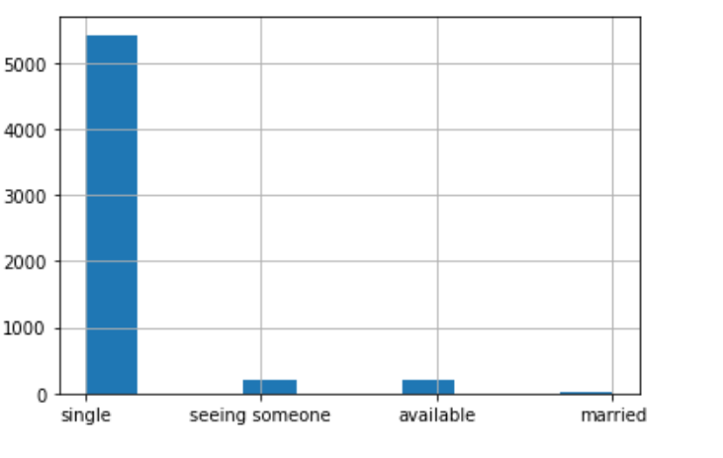
Dating Profiles – Explored Values for Features

Slide 3
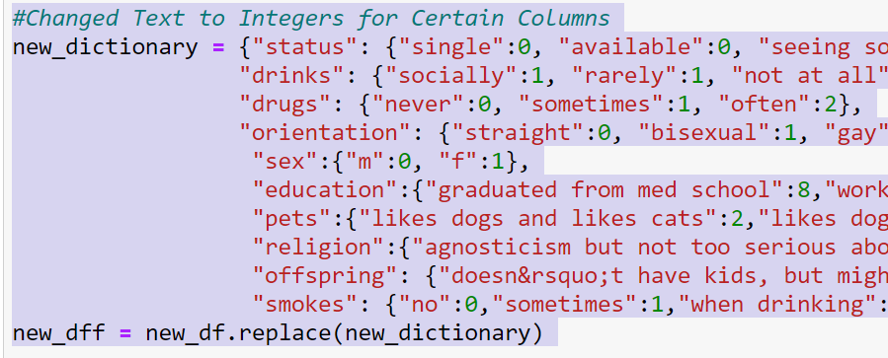
Converted to Integers and Performed some Groupings
Goal was to group features into “like” groups for whether someone wanted children, their relationship with religion, educational levels, had pets, etc. If this were a real exercise, these values should be based on psychological research as to what should or should not be grouped together, i.e., what makes someone compatible?
Caveat: I did not find this dataset inclusive. To increase inclusivity, there should be additional categories, inter alia, on gender and orientation.

Slide 4
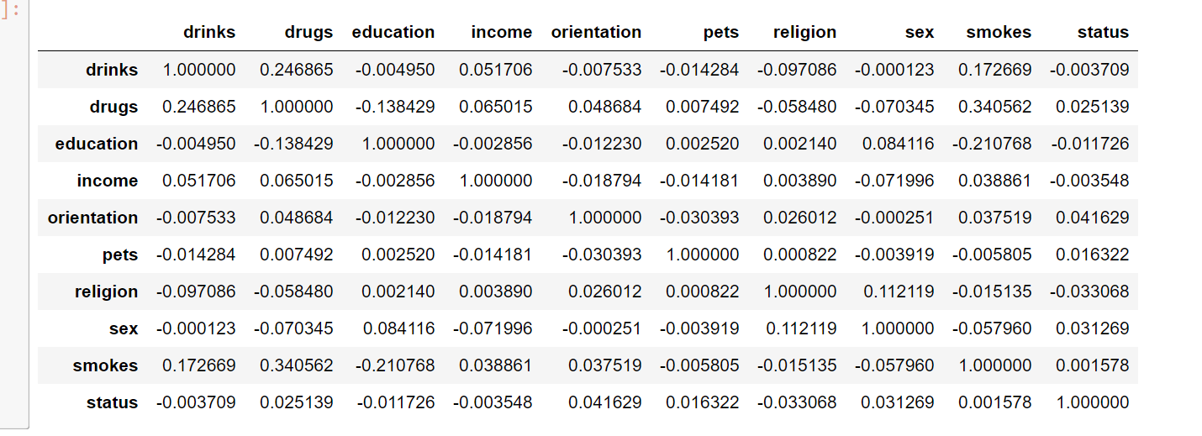
Correlation: nothing highly correlated, can see some correlation between drinking, drug use and smoking

Slide 5
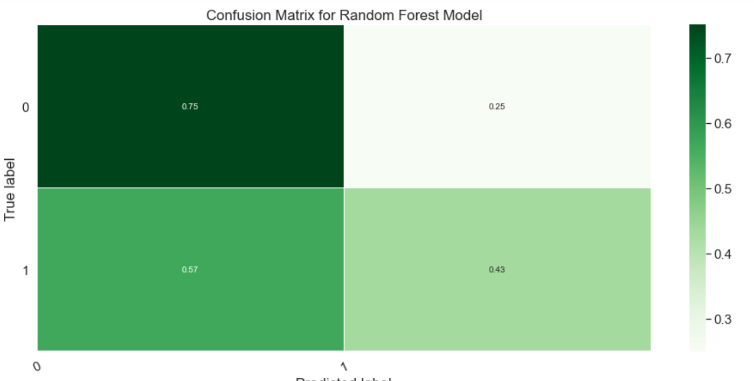
Used Random Forest to predict labels from other labels; below is a Gender Prediction 62% Overall, predictions on Drug use and Drinking were over 75%.

Slide 6
Ultimately, I switched to an unsupervised model
I removed classifications such as gender, orientation, and age under the rationale that if someone was looking for a dating match, these preferences would be selected
I used Kmeans clustering
Once I got to 100 clusters, I started seeing interesting groupings on education, income, religion, drinking level, drug use, etc.
My conclusion is that a similar process could be used to suggest profiles based on a number of these features that the person has in common: educational level, whether they want children, like dogs/cats, whether religion is important to them, how much they drink, whether they smoke or use drugs, and income level

